Slide 1
KAHULUI POWER PLANT Retirement Issues
October 3, 2014
- - DRAFT - -
Confidential

Slide 2
Three Retirement Issues
Kahului Voltage Support
Replacement Firm Capacity
New EPA NPDES (National Pollutant Discharge Elimination System) Requirements

Slide 3
Kahului Voltage Support
Only power source on the Kahului 23Kv system
Retirement of KPP dependent on either transmission or non-transmission line alternatives (NTLA)

Slide 4
Non-Transmision Line Alternatives (NTLA) Issues
Fast-start distributed generation “DG” (ICE)
Competitive Bid
Land purchase out of tsunami evacuation zone
Must be located on Kahului 23 Kv circuit
Permitting (Land Acquisition, Zoning, Air Permits)
BESS (Battery Energy Storage System)
Land purchase out of tsunami evacuation zone
20 MW BESS also requires 20 MW DG on Kahului 23 Kv circuit
Permitting (Land Acquisition, Zoning)
Synchronous Condensers
Tsunami evacuation zone
Does not mitigate thermal overloads on T-lines and Transformers
Demand Response (DR)
Slow response to system disturbances
Notes:
Reference: Maui D&O Response, Non-Transmission Alternatives, July 2, 2014
All alternatives must be on the Kahului 23Kv system to have any impact on the voltage.
Smart inverter technology mentioned but not enough on 23Kv circuit to affect voltage.

Slide 5
Solution Transmission Line Addition
Waiinu-Kanaha Transmission Line addition most reasonable alternative at an estimated cost of $33.9M
Expected completion 12/31/2018
Notes:
Waiinu-Kanaha line upgrade cost from PSIP.

Slide 6
Kahului Firm Capacity Replacement (Need by 2019)
16 Mw loss of capacity – HC&S contract expiration
34 Mw loss of capacity – KPP retirement

Slide 7
PSIP Preferred Plan
16.2 MW in 2019. Two 8.1 MW Dual Fuel Fast-Start ICE units (Waena-LNG)
24.3 MW in 2019. Three 8.1 MW Dual Fuel Fast-Start ICE units (South Maui-ULSD)
10 Mw New Wind - Capacity Value of 0.3 MW
Demand Response of 3.0 MW
Notes:
Reference: MECO PSIPResource Plan (also MECO System Improvement and Curtailment Reduction Plan [Preferred Plan])
MECO will need at least 56 MW reserve to meet Unit Addition Planning Criteria.
Note: With the retirement of KPP, the scenario of a unit on overhaul (29 MW) and the loss of the largest unit (29 MW), MECO will not meet forecast peak load. This will be in violation of the Unit Addition Planning Criteria.

Slide 8
ISSUES
Waena DGs
Competitive Bid
RFP process
Ambient air and met data collection
Need date 1/1/2019
South Maui DGs
Competitive Bid
RFP process
Site acquisition
Ambient air and met data collection
Need date 1/1/2019
Notes:
Waena – Ambient air data may be allowed from DOH monitoring sites. Met data is stack height specific and can use SODAR for collection. Both require at least 1-yr of data collection.
South Maui – Same requirements as Waena for ambient and met data collection.

Slide 9
ISSUES
New Wind
Competitive Bid
RFP process
Land acquisition
Permitting (Land Acquisition, Zoning)
Capacity Value
Demand Response
Establish DR program
Limited customers

Slide 10
Ideas to Expedite RFP Process
Be specific of the size and type of generation technology MECO will accept to avoid having to evaluate too many technologies.
Identify the location to shorten environmental permit process.
Consider multiple resources to meet capacity needs.
Determine who will be responsible for infrastructure (if at Waena site).
Notes:
From Bob Isler August 2014
Note: If we collect Met data for Wartsila units the data is only good for this unit as it is stack height specific.

Slide 11
National Pollutant Discharge Elimination System (NPDES)
End-of-Pipe Discharge - New NPDES requirements
Affect all four Kahului units

Slide 12
Solution
HECO Environmental discussions with DOH
DOH may allow MECO a 9½ year compliance schedule
Final permit issued by end of 2014
Notes:
New NPDES permit requirements will affect new generation for Maui.

Slide 13
EPA 114

Slide 14
END

Slide 16
Backup Slides

Slide 17
KAHULUI VOLTAGE SUPPORT BACKUP SLIDES

Slide 18
Kahului Voltage Support
The Kahului Power Plant presently is the only means available to support the voltage in the Kahului area. In order to retire the Kahului units either transmission or non-transmission line alternatives (NTLA) are needed to ensure adequate voltage for the largest customer base on Maui.

Slide 19
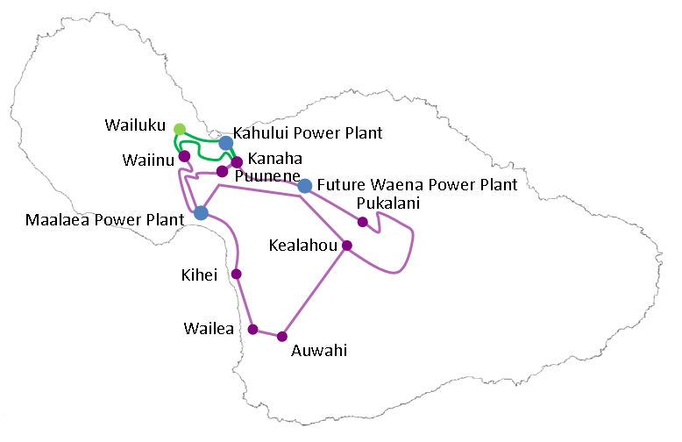
Maui Transmission Lines

Slide 20
REPLACEMENT FIRM CAPACITY
BACKUP SLIDES

Slide 21
Kahului Firm Capacity Replacement (40 MW Needed by 2019)
With the retirement of KPP (34 MW) and the expiration of the HC&S firm purchase power contract extension (16 MW) there is a need to replace this firm power on the Maui system to meet system load.

Slide 22
GENERATION CAPABILTIES (Gross) Maui Division
2014 2019
Kahului Power Plant 34.0 MW 0.0 MW
Maalaea Power Plant 212.1 MW 212.1 MW
Hana Sub-station 2.0 MW 2.0 MW
HC&S Firm Capacity 12.0 MW 0.0 MW
HC&S System Protection 4.0 MW 0.0 MW
Total 264.1 MW 214.1 MW Peak Forecast 197.9 MW 218.3 MW
Notes:
(2012TY Rate Case) Docket No. 2011-0092, MECO-701, Page 3
Peak Forecast adopted 6/2014. Same forecast used for PSIP production simulation.

Slide 23
Capacity Replacement Alternatives
Wind – 10 MW of New Wind in 2019. Capacity value 300 KW
DR (Demand Response) – 3 MW in 2019
Energy Storage – 20 MW BESS regulation and 20 MW BESS contingency reserve in 2019. This does not add capacity.
Firm Generation – 24.3 MW DG (South Maui-ULSD) and 16.2 MW DG (Waena-LNG)

Slide 24
GENERATION CAPABILTIES (Gross) Maui Division
2019
Maalaea Power Plant 212.1 MW
Hana Sub-station 2.0 MW
Waena DG 16.2 MW
South Maui DG 24.3 MW
Wind Capacity Value 2.3 MW
Demand Response 3.0 MW
Total 259.9 MW
Peak Forecast 218.3 MW
Reserve (58 MW Required) 41.6 MW
Notes:
(2012TY Rate Case) Docket No. 2011-0092, MECO-701, Page 3
Peak Forecast adopted 6/2014. Same forecast used for PSIP production simulation.

Slide 25
Wind
2 MW Capacity Value based on the aggregated capacity value of the three existing wind farms (KWP1, Auwahi, KWP2).
Capacity value of future wind farms will be 3% of the nameplate value of the facility added.
Lead time dependent upon wind farm developer.
PSIP assumes 10 MW New Wind 1 will come online in 2019.
Notes:
Intercompany Correspondence: Capacity Value of Variable Generation for PSIP, July 21, 2014, Page 2
Response from PSIP r2 (draft)

Slide 26
Demand Response (DR)
Expedite procurement of contracts with DR resources.
Presently no contracts procured in 2014.
0.3 MW forecast in 2015 to kick-off program.
3.0 MW by 2016. Forecast remains flat in future years.
Notes:
Integrated Demand Response Portfolio Plan, July 2014, Page 144, Page 146

Slide 27
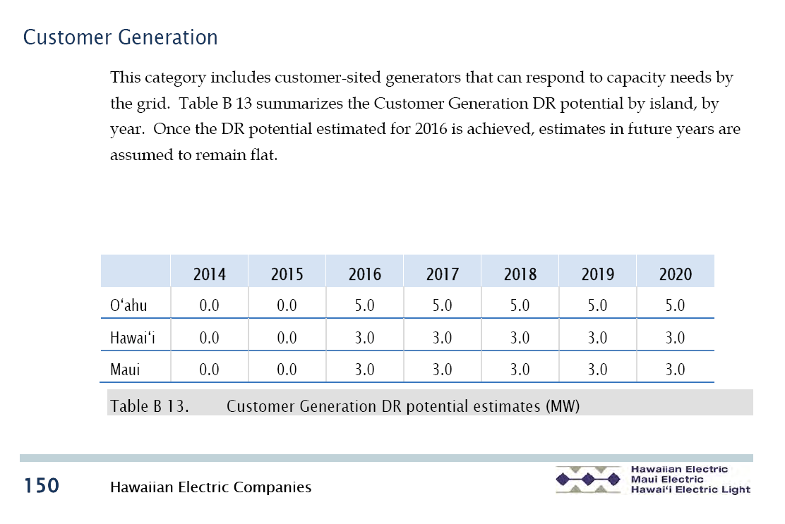
DR Forecast
Notes:
Integrated Demand Response Portfolio Plan, July 2014, Page 150

Slide 28
Energy Storage
PSIP identifies 20 MW BESS for regulating reserves in 2019.
PSIP identifies 20 MW BESS for contingency reserve in 2019.
Total 40 MW forecast in PSIP in 2019.

Slide 29
Request For Proposal (RFP)
Develop Competitive Bid RFP Framework
- PUC Approval
Prepare RFP (Third Party)
Final Competitive Bid RFP
- PUC Approval
Solicit Bids
Evaluate Proposals (Third Party)
Award Contract
- PUC Approval

Slide 30
Firm Generation Requirements
PSIP Preferred Plan proposed 40.5 MW DG in 2019.
Competitive Bid framework may need to be approved by PUC (1 year).
RFP needs to be developed (6 months to 1 year).
Resource evaluation, selection and contract award (6 months to 1 year).
PUC project approval (1 year to 18 months).
Air modeling and air permit acquisition (2 years).
Engineering, procurement, and construction at green field site (3 years).

Slide 31
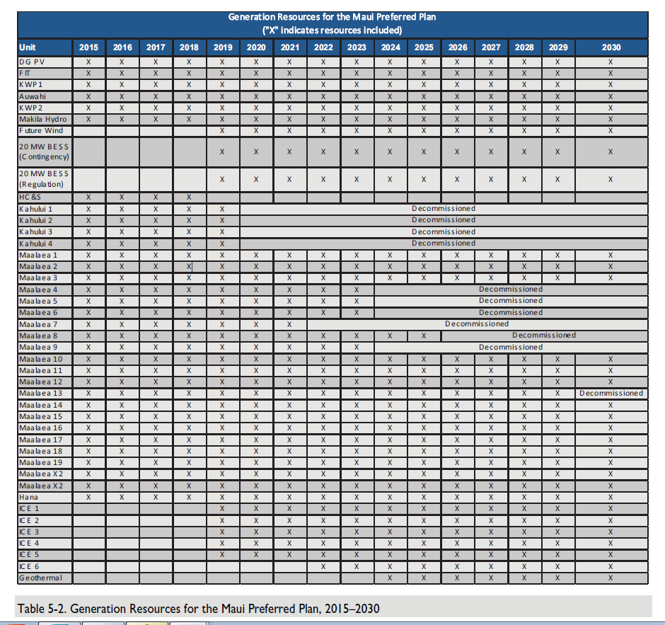

Slide 32
National Pollutant Discharge Elimination System (NPDES)
DOH/EPA proposing end of pipe discharge limits.

Slide 33
Solution
MECO does not want to invest the tremendous amount of capital to meet the new water quality requirements since the plant is scheduled to be decommissioned in 2019.
HECO Environmental discussions with DOH look like a 9½ year compliance schedule will be issued for cessation of discharges at KPP. This will move the compliance date to 2024 (beyond the plant’s retirement date). HECO Environmental expects the new permit to be issued before the end of 2014.
Notes:
New NPDES permit requirements will affect new generation for Maui.

Slide 34
NPDES REGULATIONS
BACKUP SLIDES

Slide 35
National Pollutant Discharge Elimination System (NPDES)
New NPDES requirements for Kahului Power Plant are expected to be issued this month from Hawaii DOH and the EPA.

Slide 36
General Assumptions
Avoid need for transmission upgrades
Combinations of NTAs are possible (require more detailed studies)
New generation location not in tsunami flood zone
Notes:
Reference: Maui D&O Response, Non-Transmission Alternatives, July 2, 2014

Slide 37
Wartsila Model 34DF
8 MW Dual-Fuel Fast Start Internal Combustion Engine-Generator

Slide 38
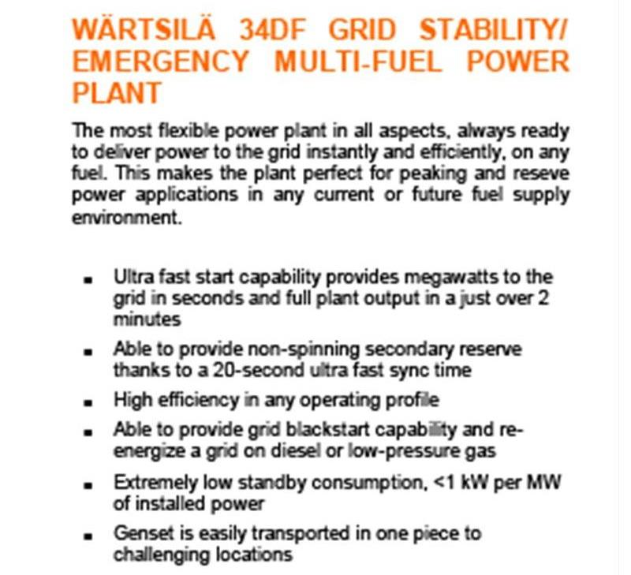
Wartsila 34DF

Slide 39
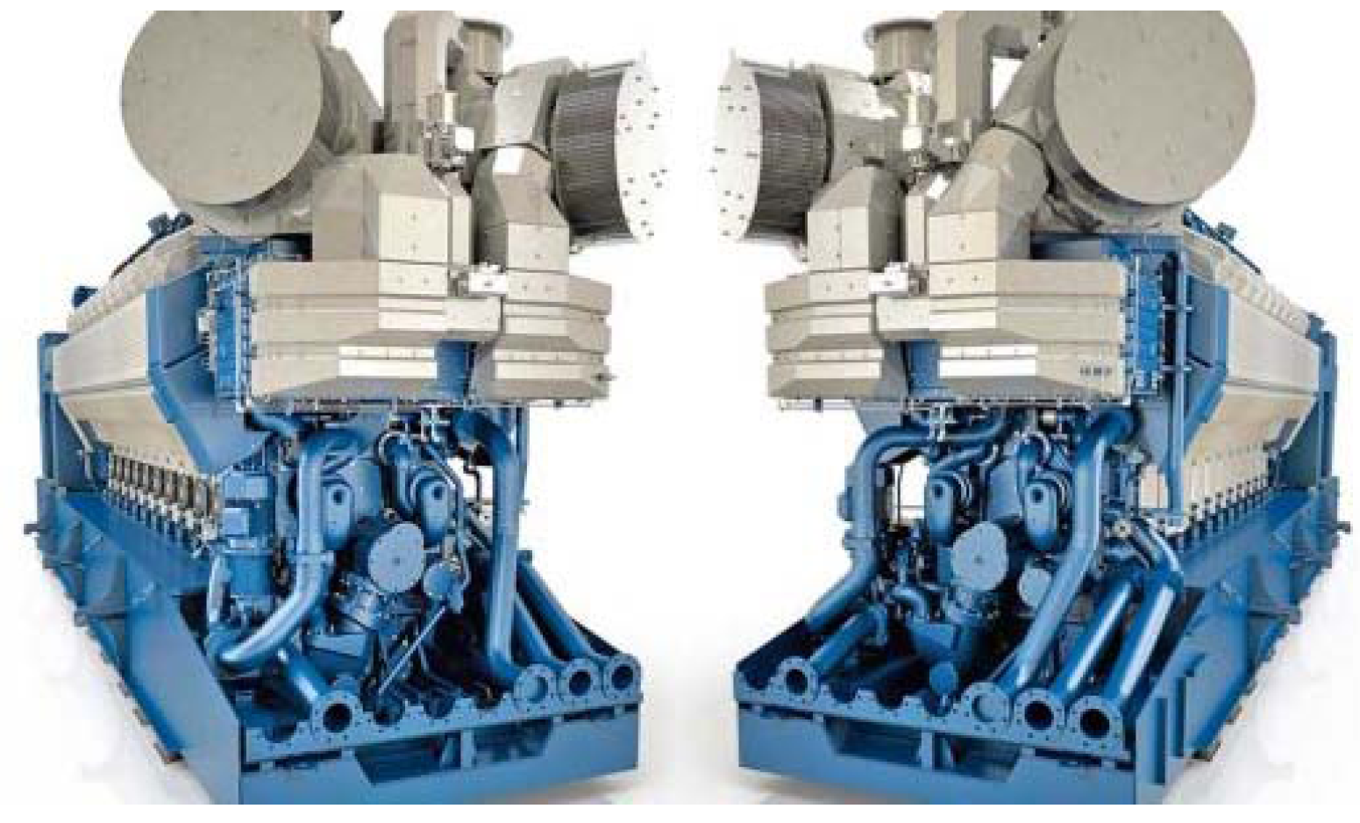
Wartsila 34DF
Notes:
Being installed by HECO at Schofield Barracks.

Slide 40
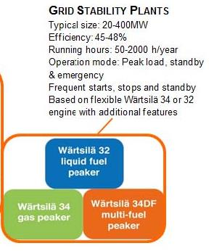
Recommended Use

Slide 41
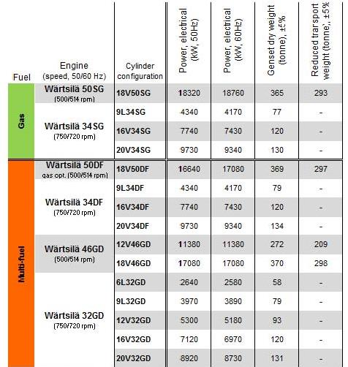
Wartsila Models

Slide 42
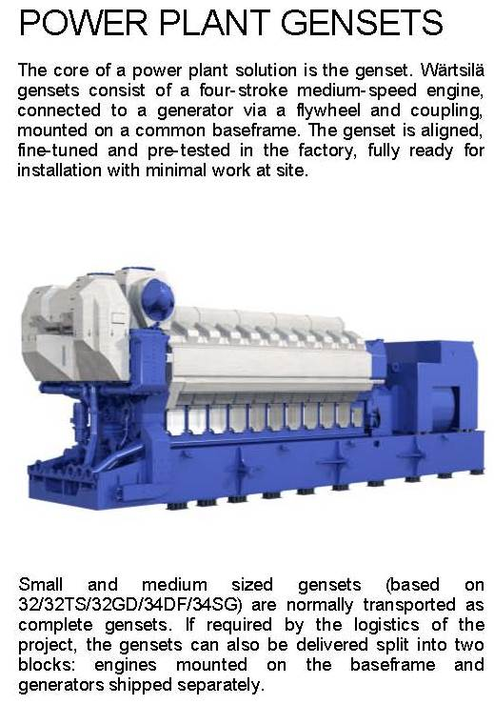
Wartsila GenSets

